Slide 1
Nexus mockup
High Five and Dive

Slide 2
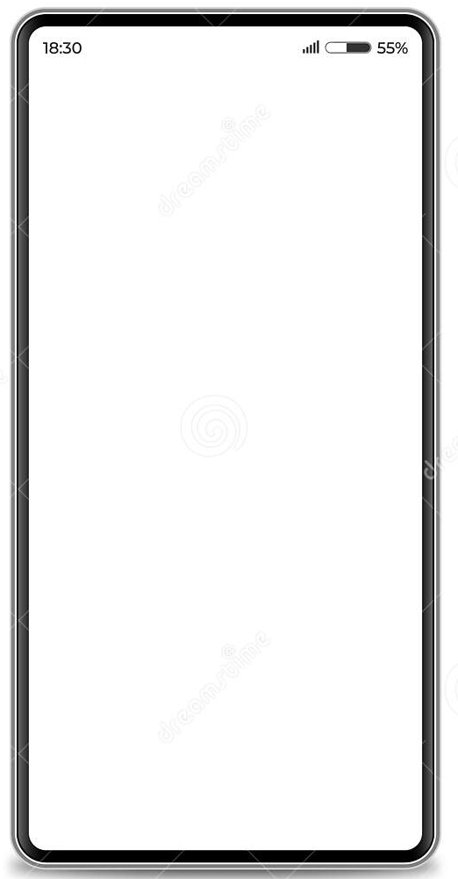
Log in
*Logo Here*
The login screen will be simple and direct. It will contain the username and password textbox in which the user can enter their account info. There will also be a registration button.
Welcome!
Username:
Password:
Don’t have an account? Click here to register!
Notes:
Anthony

Slide 3
Sign up
The user will be allowed to enter their desired username and password. Also the email that the account will be connected to.
Register:
Create username:
Create username:
Enter e-mail:
Notes:
Anthony

Slide 4

Homepage
Search
Chat
This is the main page users will first encounter as they log in to the Nexus app. Starting at the top, there is:
A Search button for users to search the app for communities, posts, other users, etc.
The Chat feature will allow the user to bring up any chat conversations they may have going on with other users.
In the center of the screen is whatever activity the user was last doing on the app. At the bottom is an array of three buttons.
Inbox will display any notifications sent to the user from communities they are active in, posts they are involved in, or anything else connected to their username.
The middle button with the three lines is a Menu button. When this is clicked, it will give the user the option to go to the settings, view profile, view followers, and see their comment and post history.
The Feed button will take the user to their feed. The feed will be customized for each member, because only the communities they have joined will show the latest and most popular posts and submissions.
/congo/
My experience in the Congo rainforest
When I first received my degree in botany, my University had a trip to the jungles of the Congo. It turned out to be one of the most enlightening trips of my life! At first, I was very nervous to tag along to such a far-off place. But, as time went on I started to really enjoy the incredible sights and sounds of the jungle! There, I ……..
Inbox
Feed
Notes:
John

Slide 5

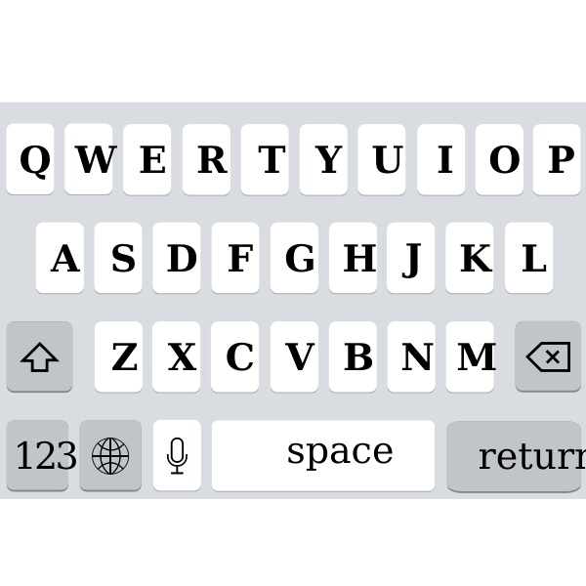
Search
Search: an|
/antiwork/
/animals/
/anime/
/animalsbeinggoofy/
/WARNING: NSFW/ (SHOW)
The search bar allows users to search for communities, users, posts, and even comments. The search engine will put a label for nsfw content, and the user will have to press the button to see it, then again to enter it as the search entry.
Notes:
Adrian

Slide 6
Chat
Direct Messages
/phonyMelon4
Hey! Wanna meet up tonight?.....
/point453
Did you see that comment I made on your post?! LOL xDT_T. They…….
/MichaelBae
I think its kind of dumb where the world is…..
/Master87
Hey I followed you, can you……
/hashashin4999
Dude stop spammin my posts about…….
The chat page will allow the user to view their direct messages with other people. It will show the user name, and a short preview of their comment. The user can press it to view all full messages.
Notes:
Anthony

Slide 7

Inbox
Inbox
You have received an award for your photo contribution to /photography/!
FunnyGuy75 has commented on your post in /bioengineering/
ArcherySarah followed you!
You have received more than 500 upvotes for your contribution to the /burgers/ community!
The inbox will be where a user can go for all of their notifications and alerts.
Popular posts from communities the user is active in
Responses, comments, upvotes, and awards on a post the user has made or contributed to
Alerts for new chat invitations from other users
Alerts for a request or follow from other users
Any notifications put forth by the app that members will need to see.
The three buttons on the bottom from left are the Feed button, which will take the user directly to their feed. The Home button will go directly to the Homepage, and the last button is a back button, for the user to do directly back to the page they were on before being in
Feed
Home
Notes:
John

Slide 8

Where you left off
/news/
Ukrainian war rages on
This feature will store where you left off the last time you visited a post, or have been on reddit. It also saves the comments you hid while browsing a post. The button will be on the homepage and can be accessed anytime. The user will have a ‘are you sure’ option when they attempt to refresh the page feed.
OnlyBans44 comment….
DrAgOnar9 comment….
CODSucks44 comment:
I can’t believe this war is still going *crying emoji* *sad emoji*
Notes:
Adrian (one post page)

Slide 9

Feed
Search:____________________
/photography/
Kate687 posted a new photo
/sewing/
My top 10 tips to stay consistent with your patterns
/gaming/
Here is what I think after 80hrs with Castlevania
/hiking/
Does anyone have any suggestions as to where to hike in NE Minnesota?
/space/
MIT has found a new exoplanet names yt6695
Here is what the Feed screen will feature:
A search bar at the top, incase while going through posts the user wants to search for something of interest or something new.
A scrollable feed with all of the communities the user is part of. The feed will be refreshed every time the user reloads the page, with the newest or most popular posts in each of the communities the user is a member of.
A button to go back to the homepage
A button to go back to the previous activity.
Home
Notes:
John

Slide 10

Menu
Menu:
The menu allows you to change or view settings that you may want to change or just check.
Your profile: shows your user profile, avatar, username.
Security: Change email, password, add security authentication when logging in.
Theme: Change the theme to dark or light, can add more in preferences.
Preferences: Accessibility and visual settings that suits users’ needs.
Settings: View current settings for the app.
Your Profile
Security
Theme: Light
Preferences
Settings
Notes:
Adrian

Slide 11


Community Page
/Dogs/
Puppy Photos
Each community has their own home page to post their designated content
Where posts can be seen such as.
-Images
-Videos
-Discussions
Discussion:
What makes a good Dog?
Dog chasing squirrel
Home
Home

